Slide 1

ASSIGNMENT-2
Submitted To:
Niaz Ashraf Khan
Lecturer
University of Liberal Arts Bangladesh
Submitted By:
Name: Md Abul Hashem
Roll: 222014097
Course : CSE1201
Section: 2

Slide 2
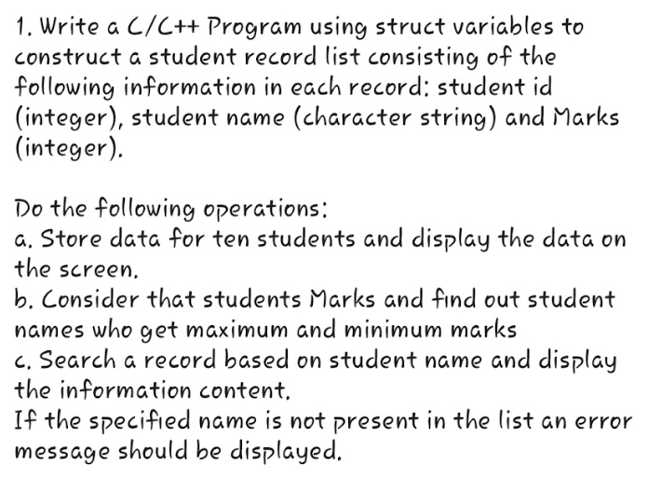
Problem on String 1
Write a program in C to check whether a given string is palindrome or not.
Problem on String 2
Write a program in C to reverse order of words in a string.
For example:
Input string : I love ULAB
ExpectedOutput: ULAB love I
Input string : Structured Programming Theory
ExpectedOutput: Theory Programming Structure
Problem on Structure 1

Slide 3
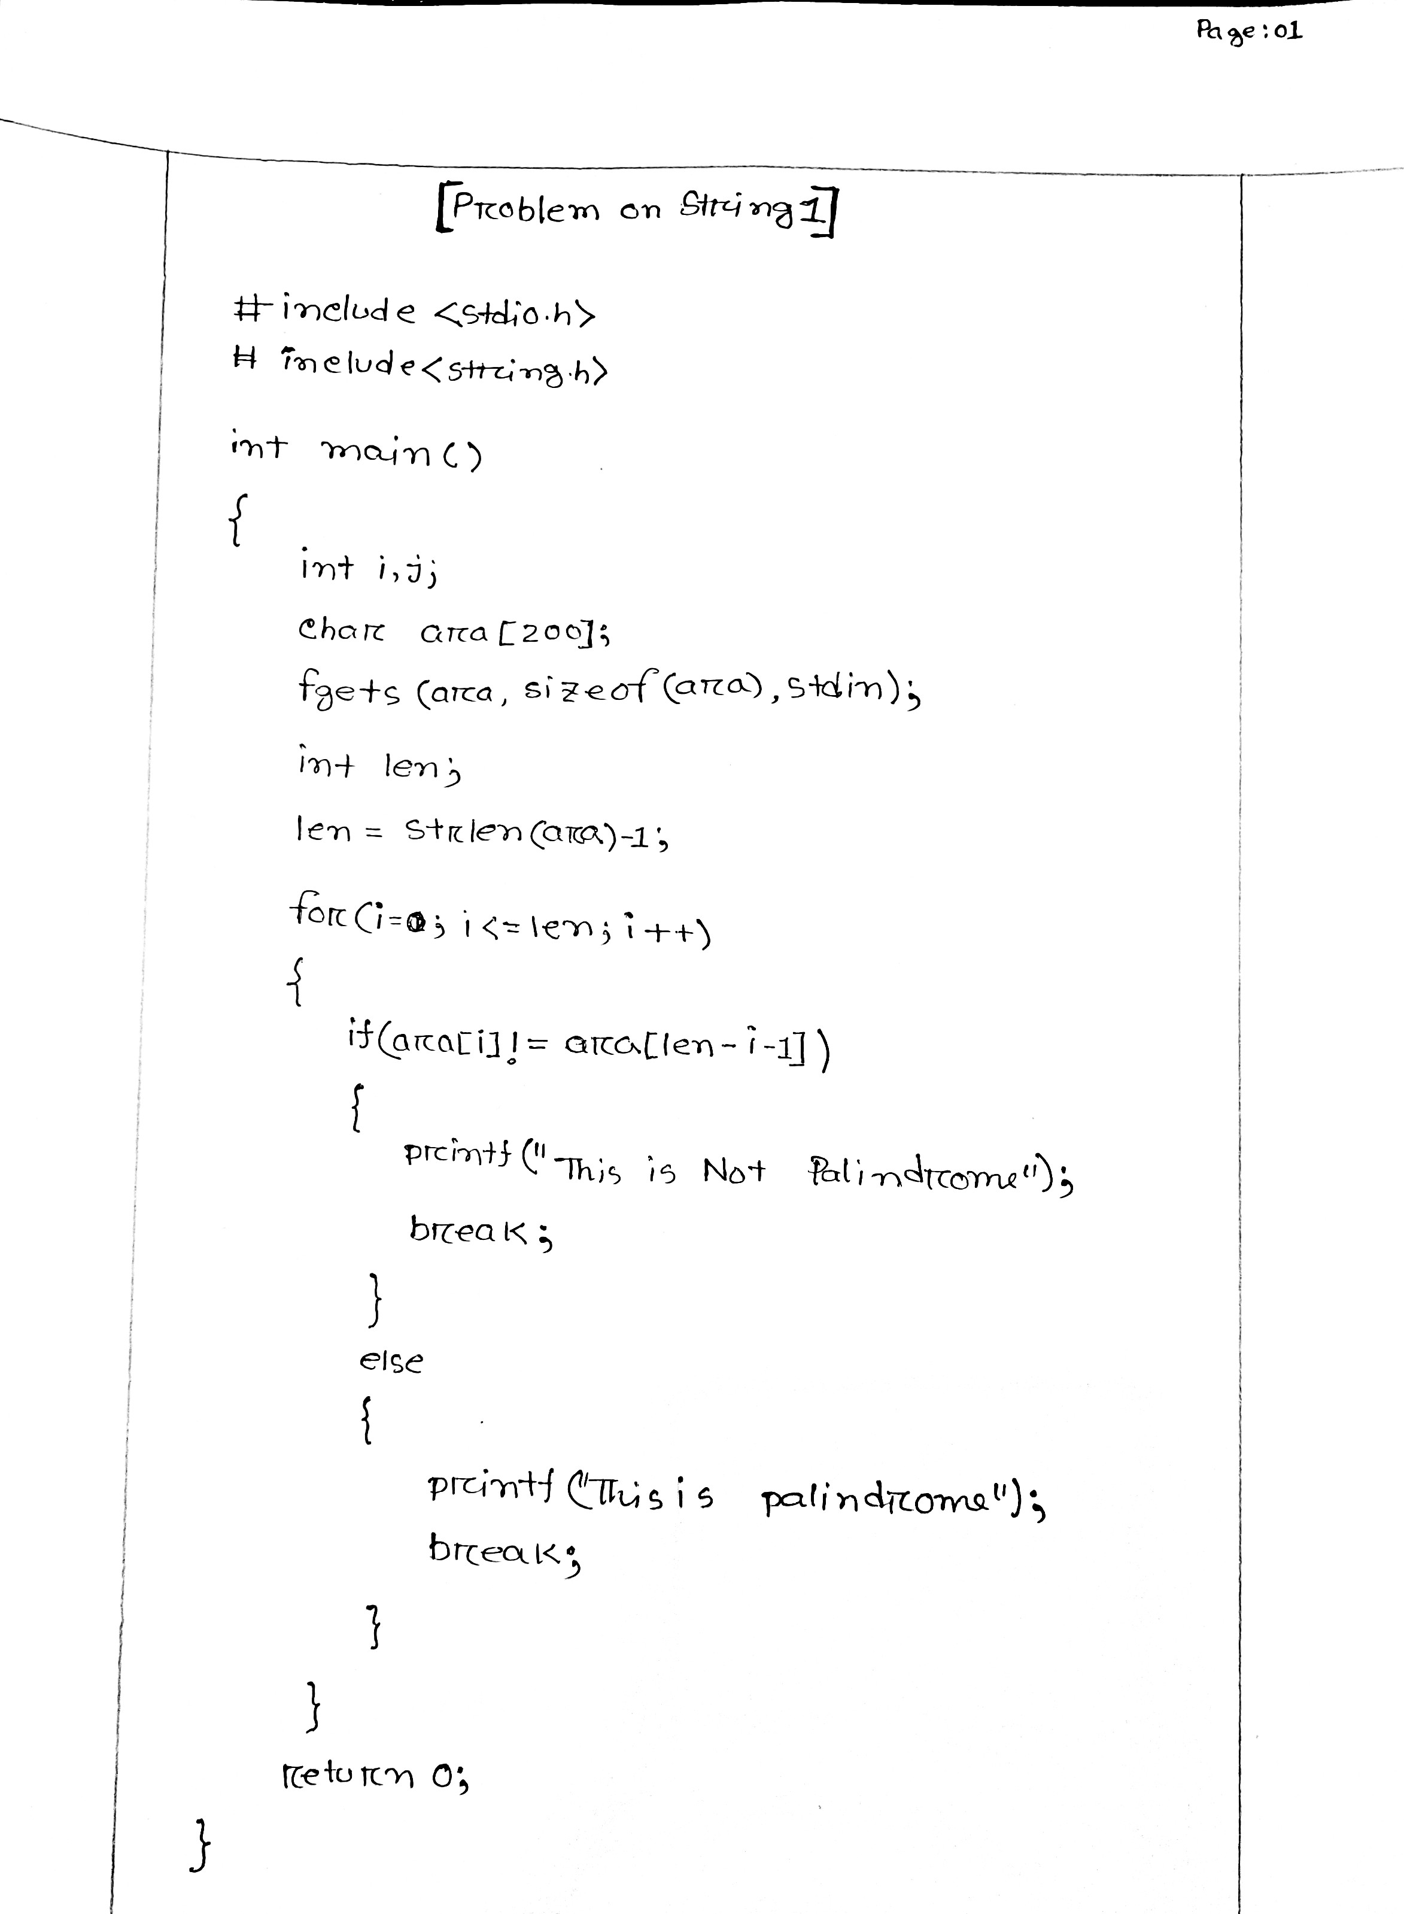

Slide 4
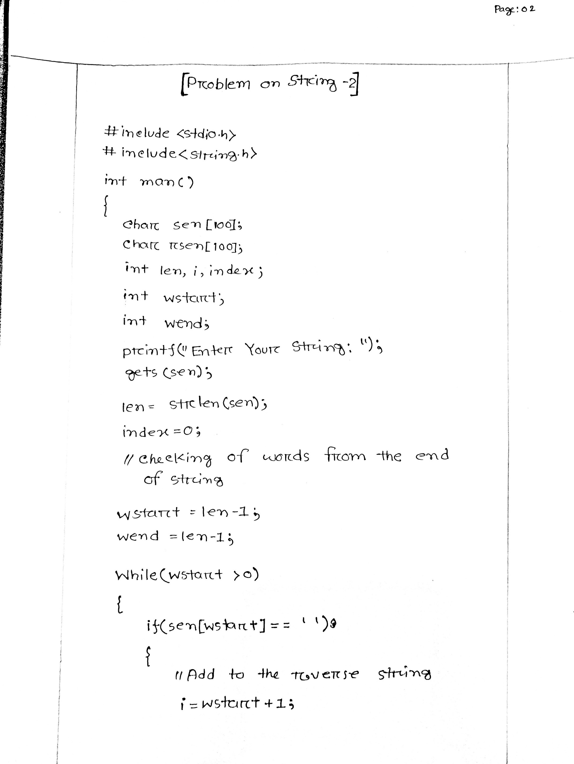

Slide 5
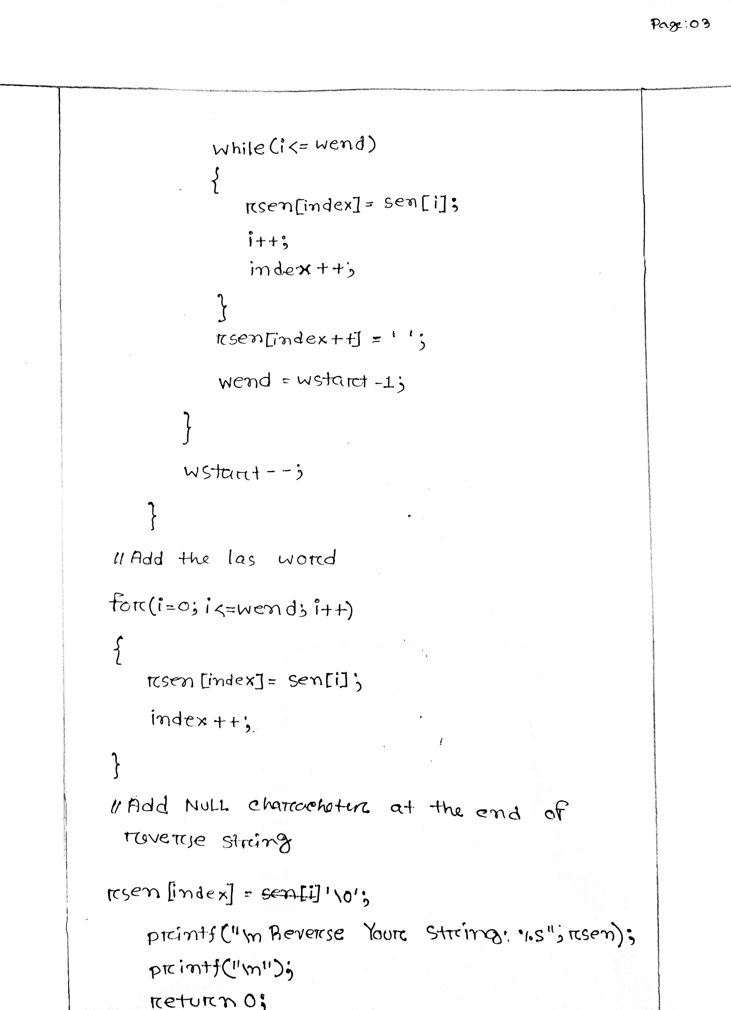

Slide 6
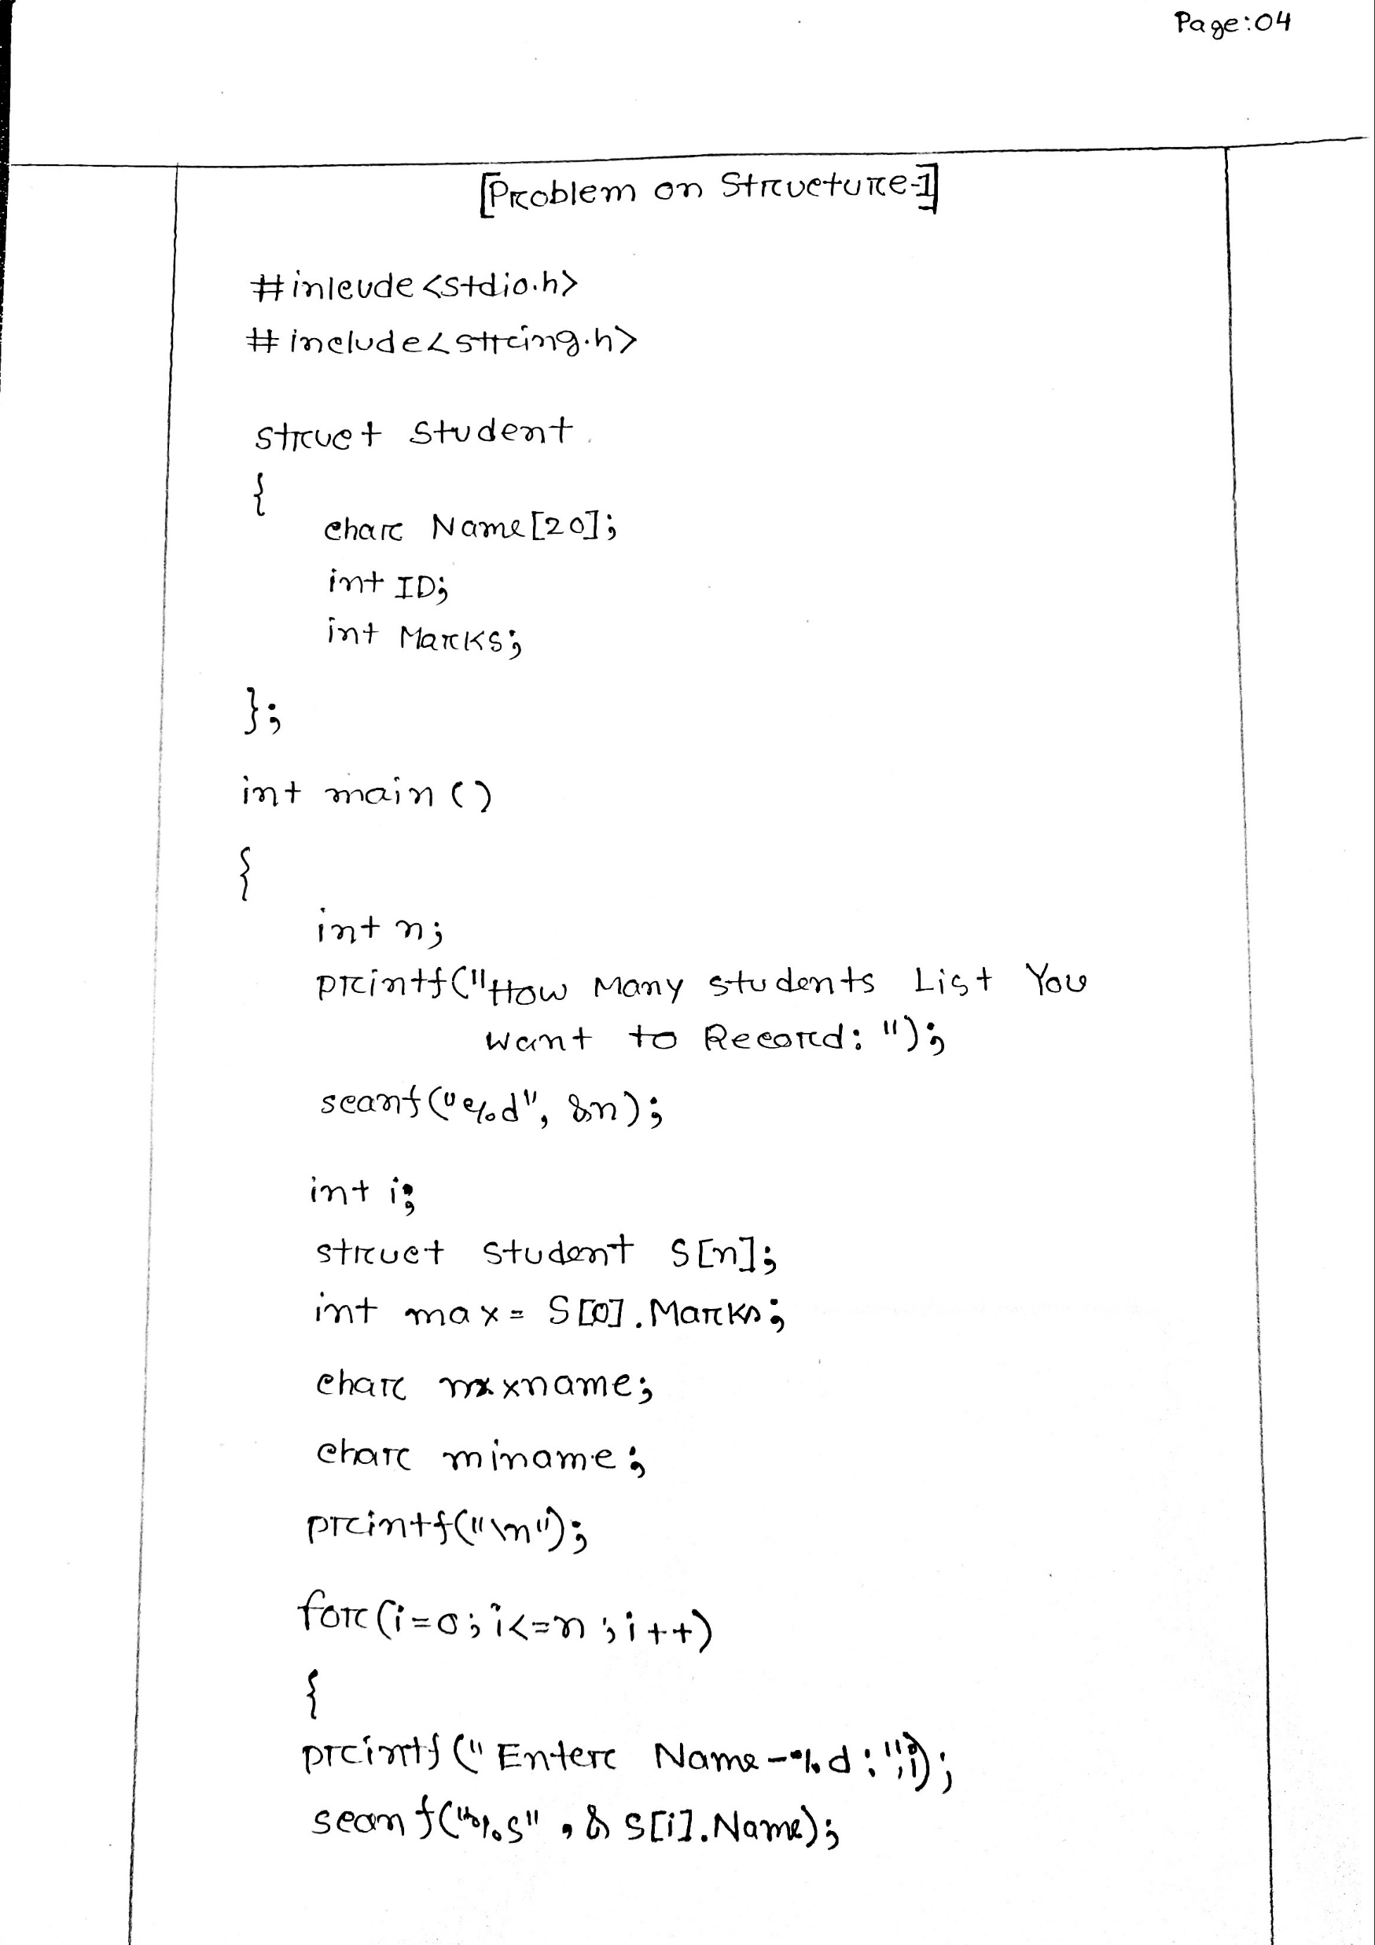

Slide 7
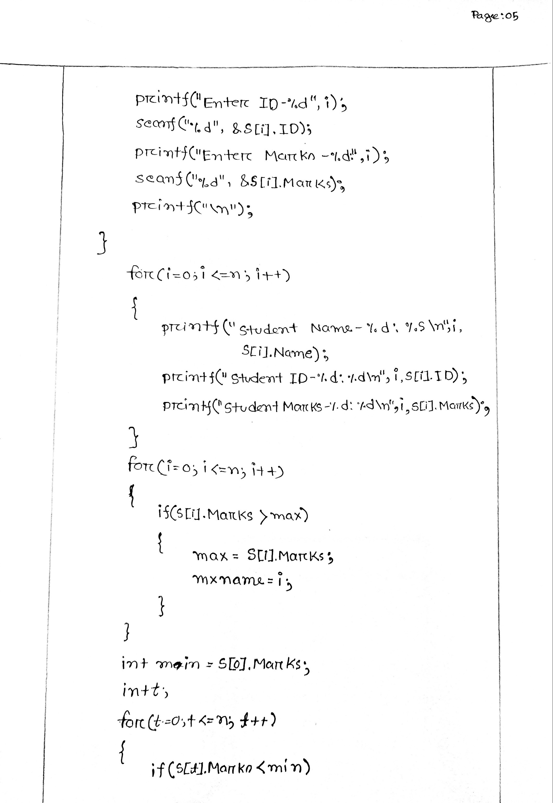

Slide 8
